Slide 1
How perception perceives number, time, and space
Darko Odic
University of British Columbia
October 20th, 2019

Slide 2
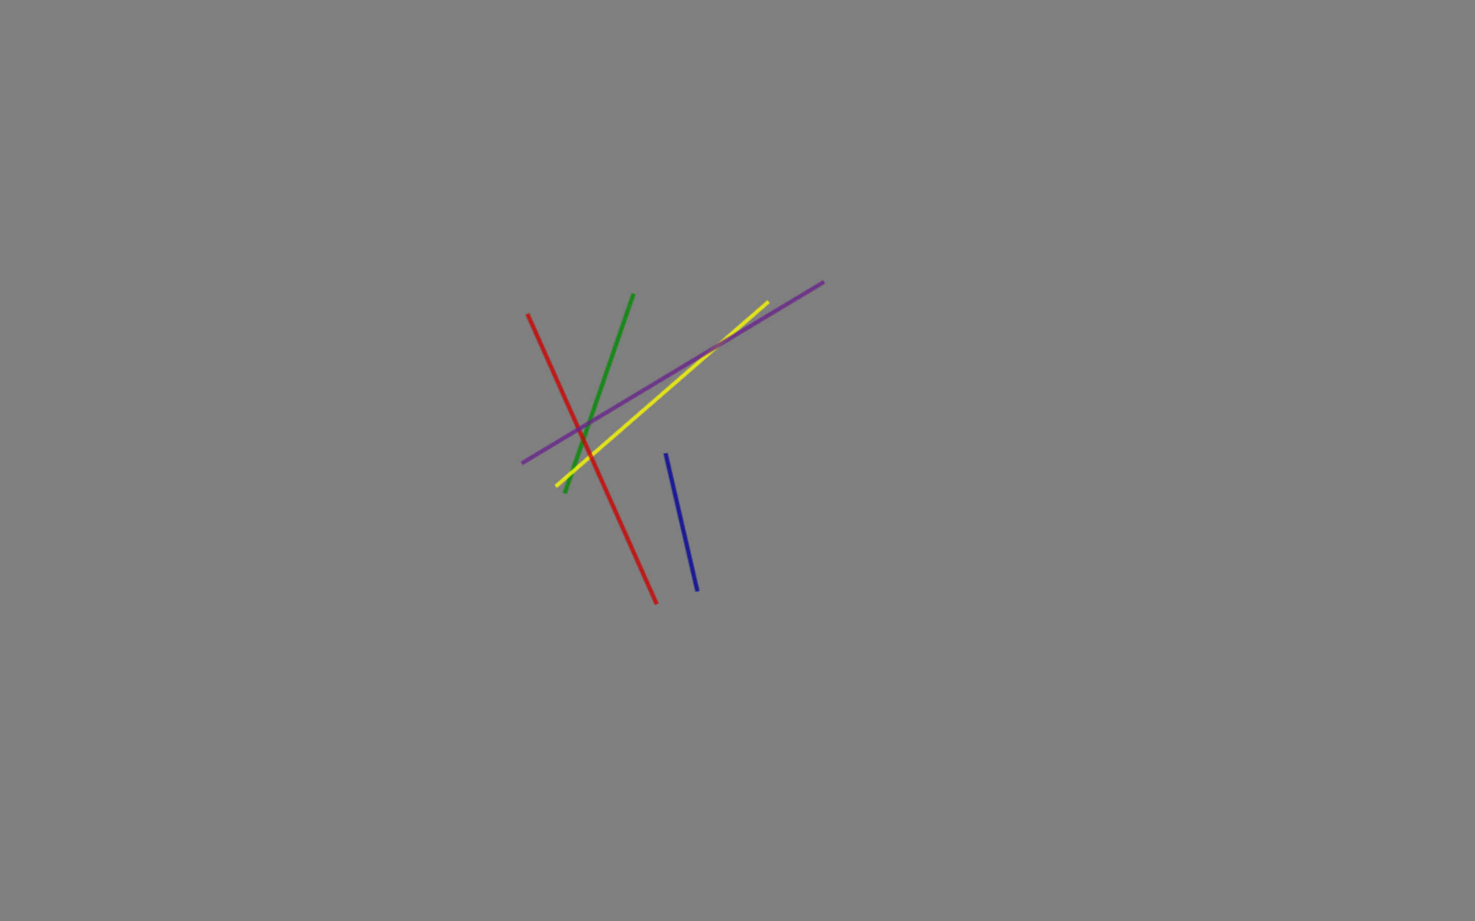
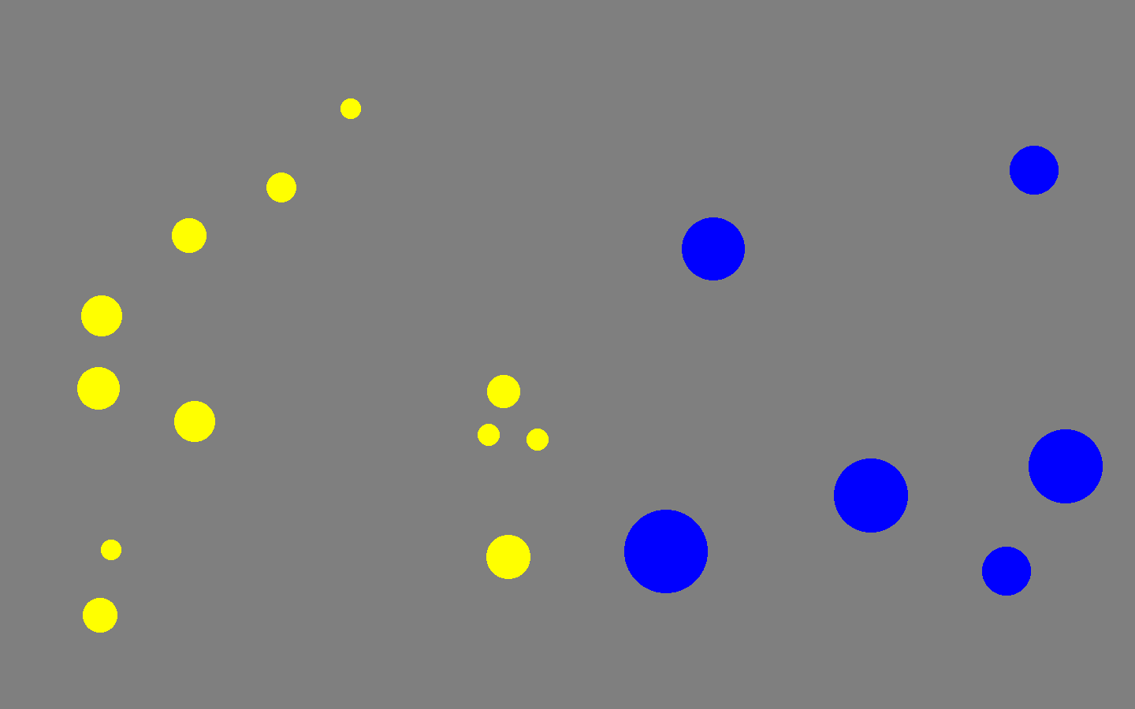
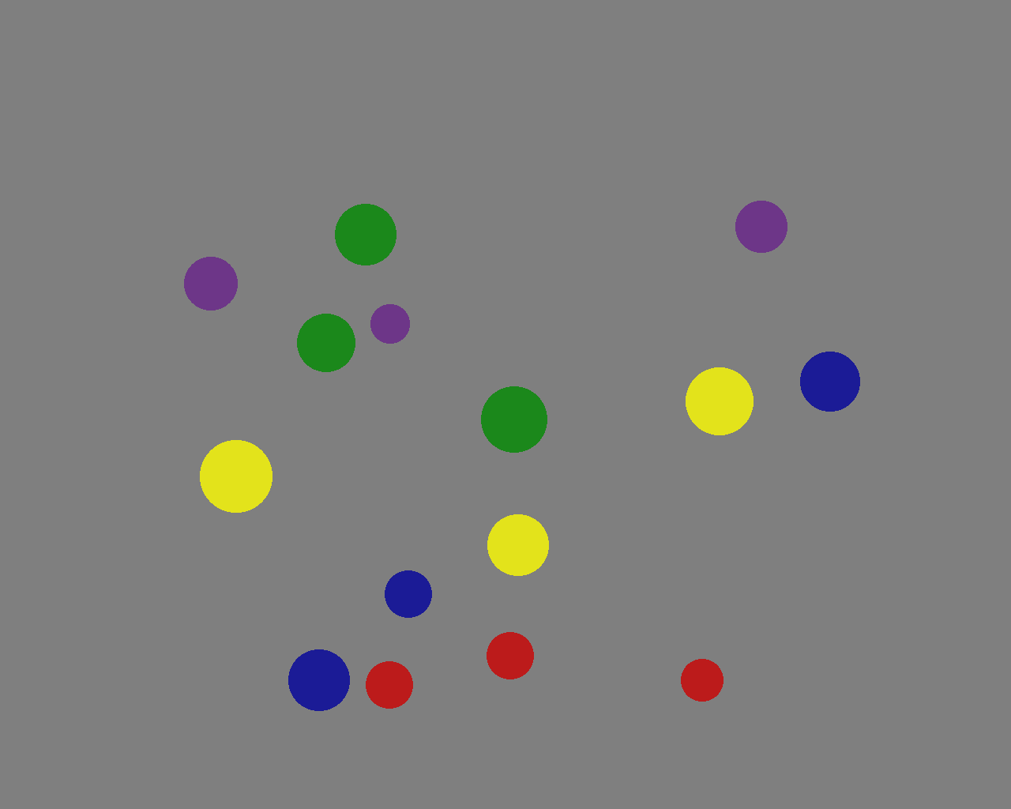

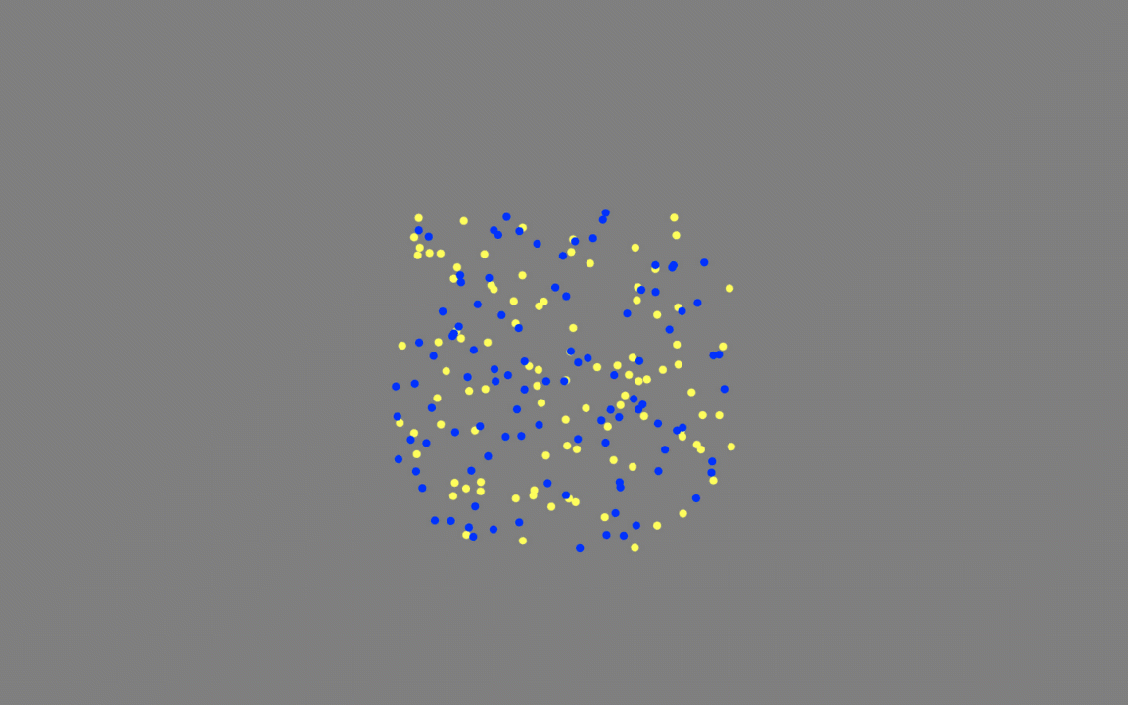




Slide 3
Plan for Today
My goal today is to share three take-aways from recent work on perceptual magnitudes, linking each to potential implications for visualization research.
Our perception of number, time, and space are domain-specific and independent of each other (i.e., errors in one dimension are not related to errors in another).
Nevertheless, there is a hierarchy of interference effects between them that especially affects number perception (but they are context-dependent and changeable).
Perceptual magnitudes are optimized for relative comparison and absolute judgements are slow, serial, and imprecise.

Slide 4
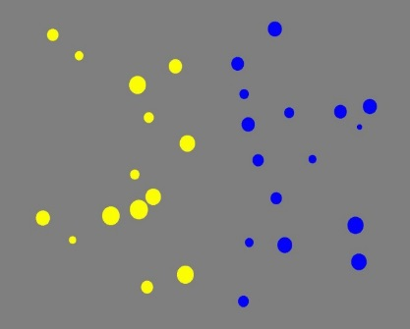
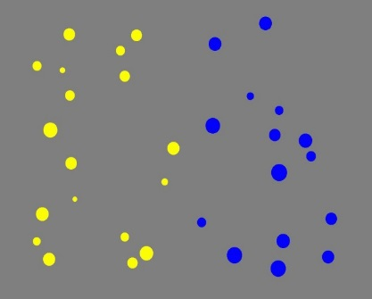
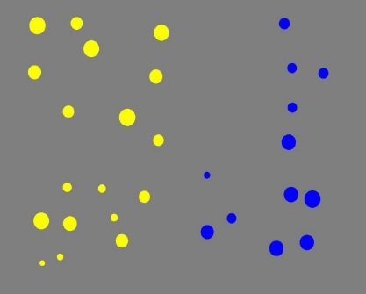
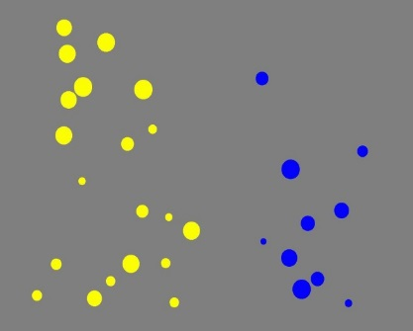
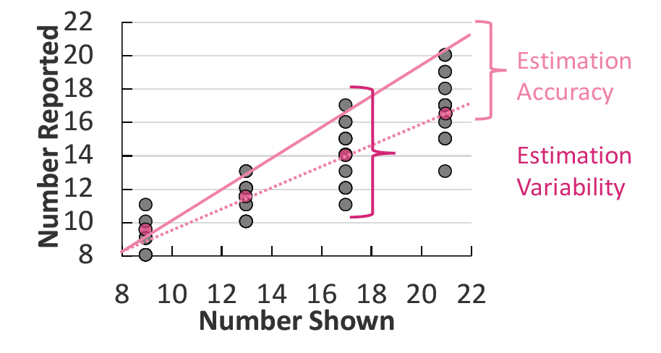
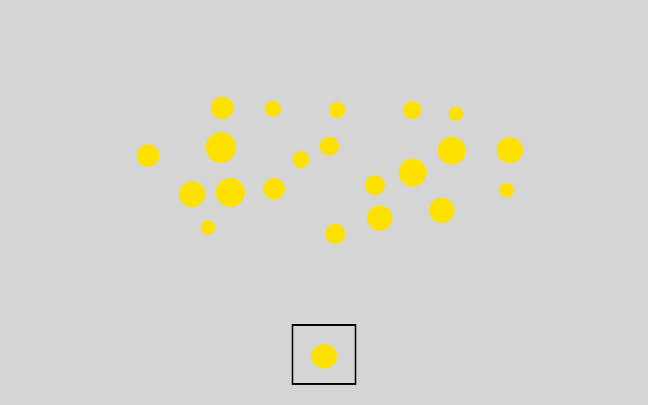

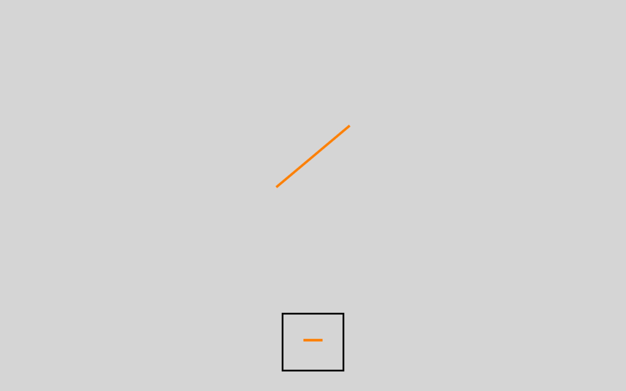
General Methods
The majority of data I’ll present today will be behavioural from Magnitude Discrimination or Magnitude Estimation tasks, with accuracy/sensitivity as the dependent variable of interest.
Higher Ratio = Easier Difficulty
Discrimination
Ratio 1.14
(16 / 14 dots)
Ratio 1.20
(18 / 15 dots)
Ratio 1.50
(18 / 12 dots)
Ratio 2.00
(20 / 10 dots)
Estimation

Slide 5

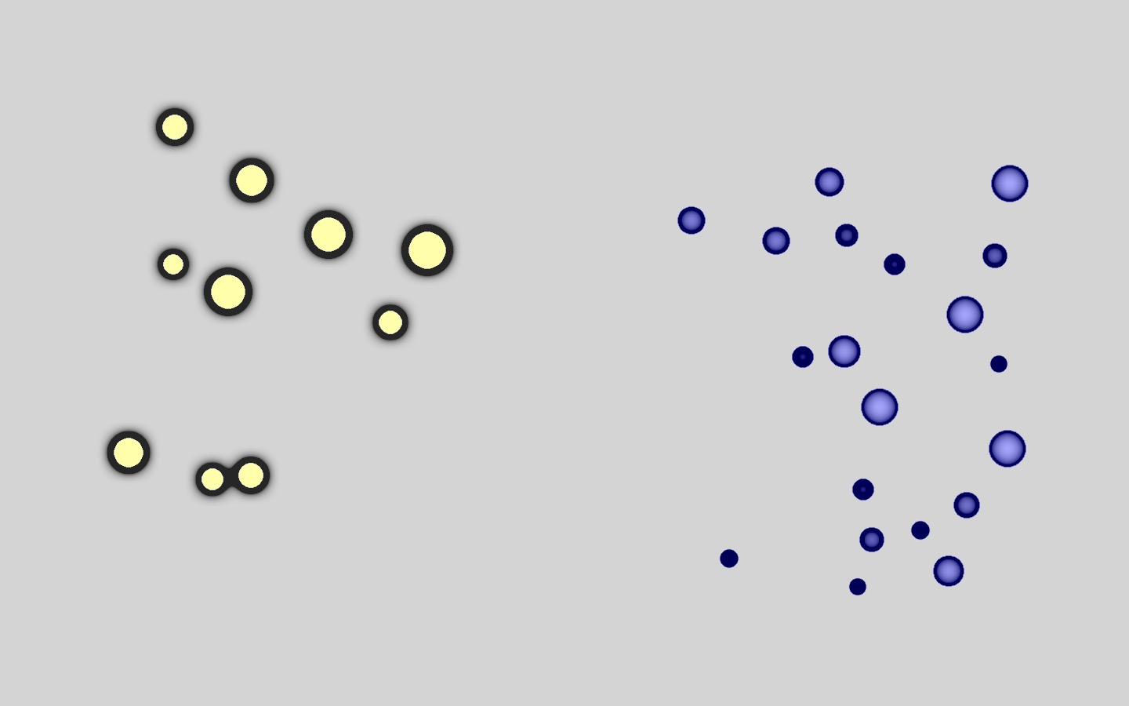
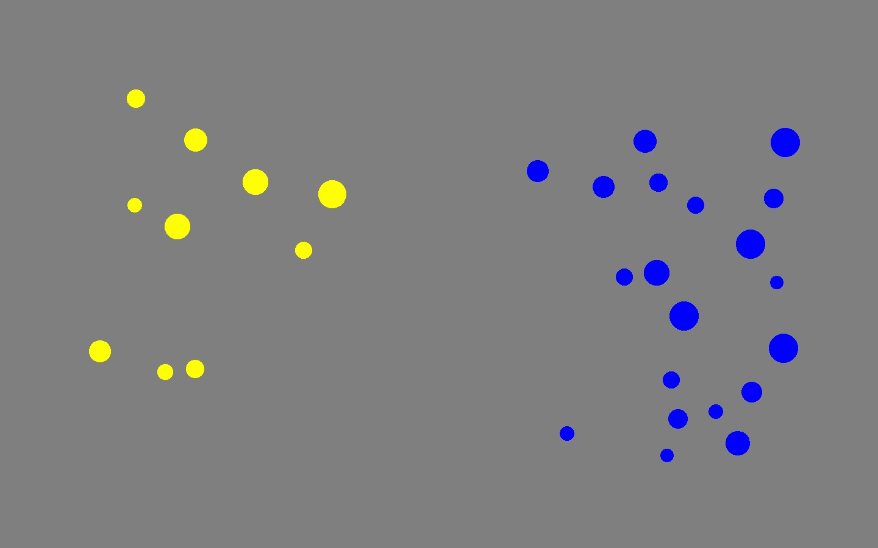
Part 1: How do we perceive number?
Number is a primary visual feature, like colour, contrast, size, orientation, etc. (e.g., Burr & Ross, 2008)
Number is derived from other features, such as area, contour length, convex hull, or density (e.g., Allik & Tuulmets, 1991, Gebuis & Reynvoet, 2011, Durgin, 1995, Dakin et al., 2011).

Slide 6
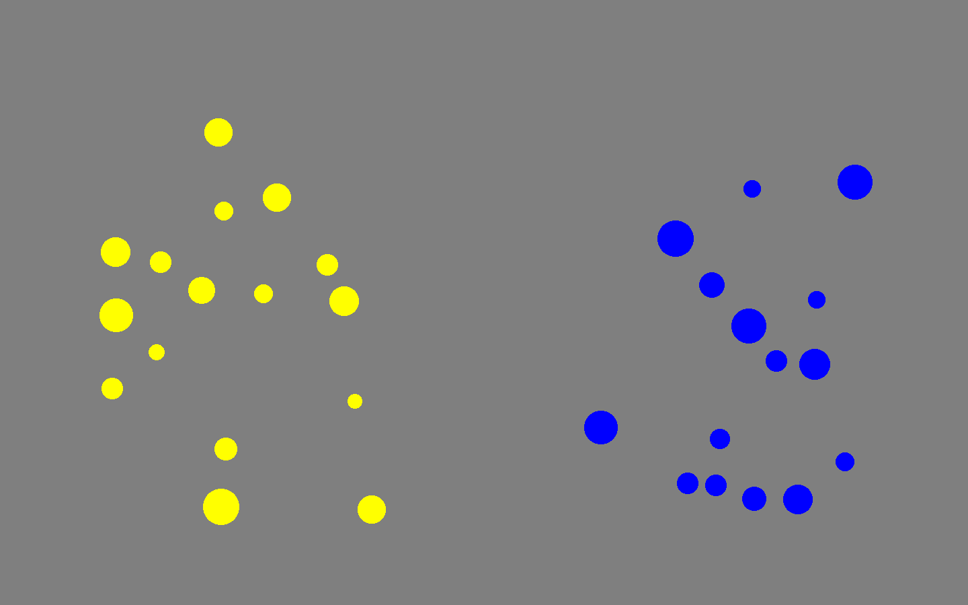

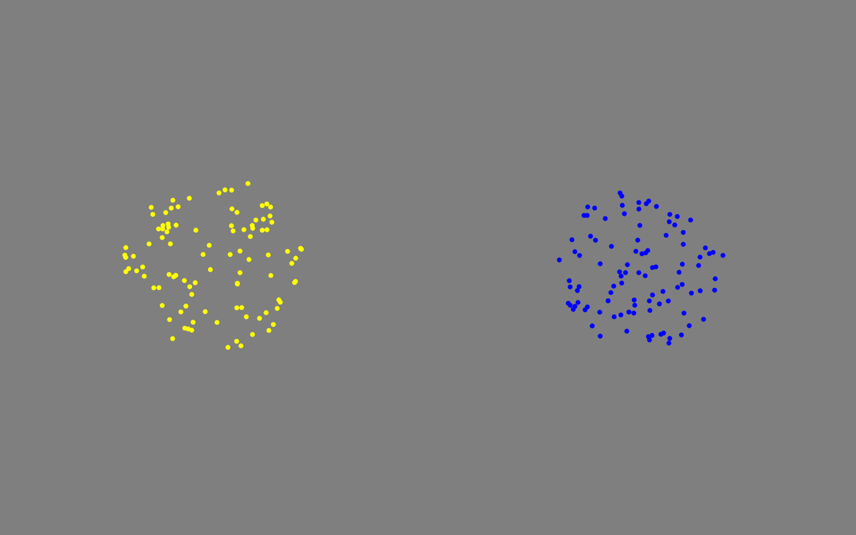


Experiment 1: Is number derived?
If perceptual number is derived from other dimensions, then we should expect that errors in number perception should correlate with errors in other dimensions.
Number
Area
Density
Length
Time
N = 200 children and adults
Intermixed trials to prevent task order effects
No feedback.
Each trial on the screen for 1000 milliseconds (too quick to allow for counting).

Slide 7
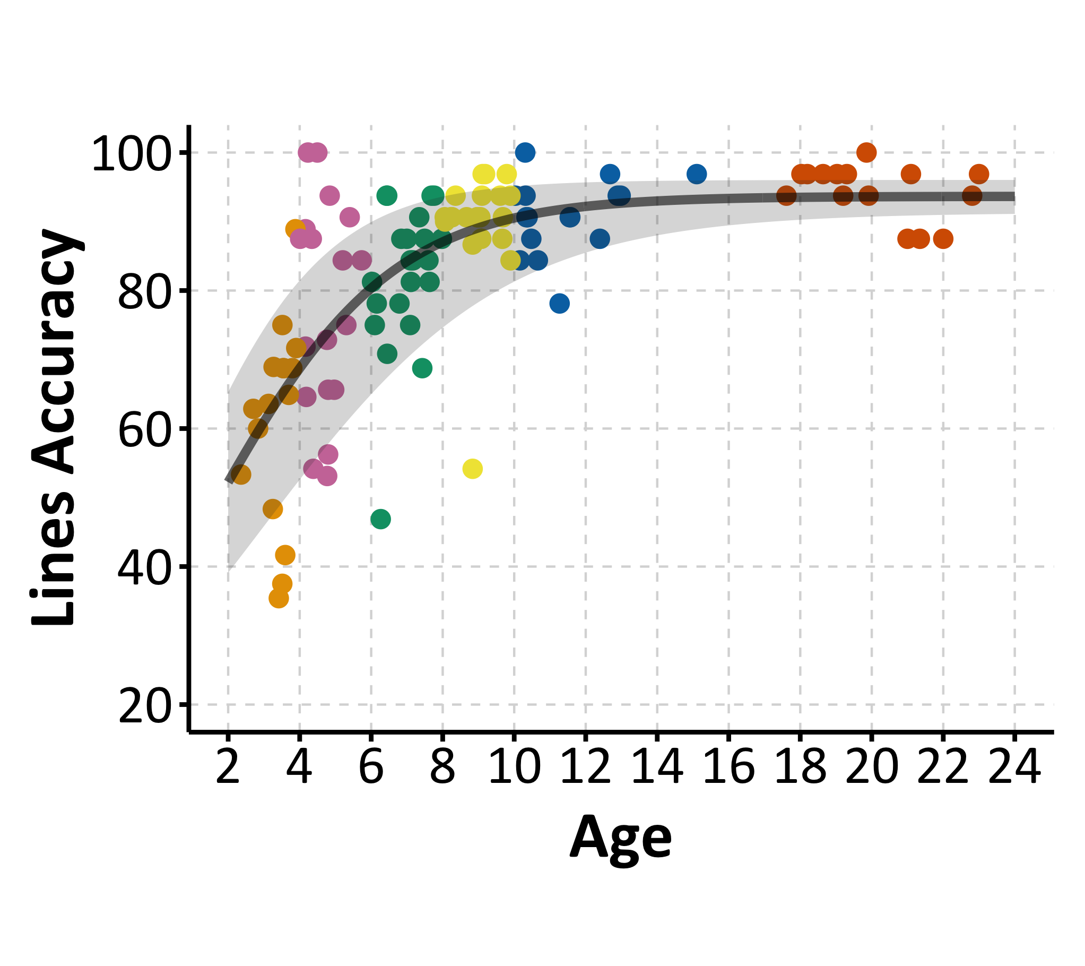
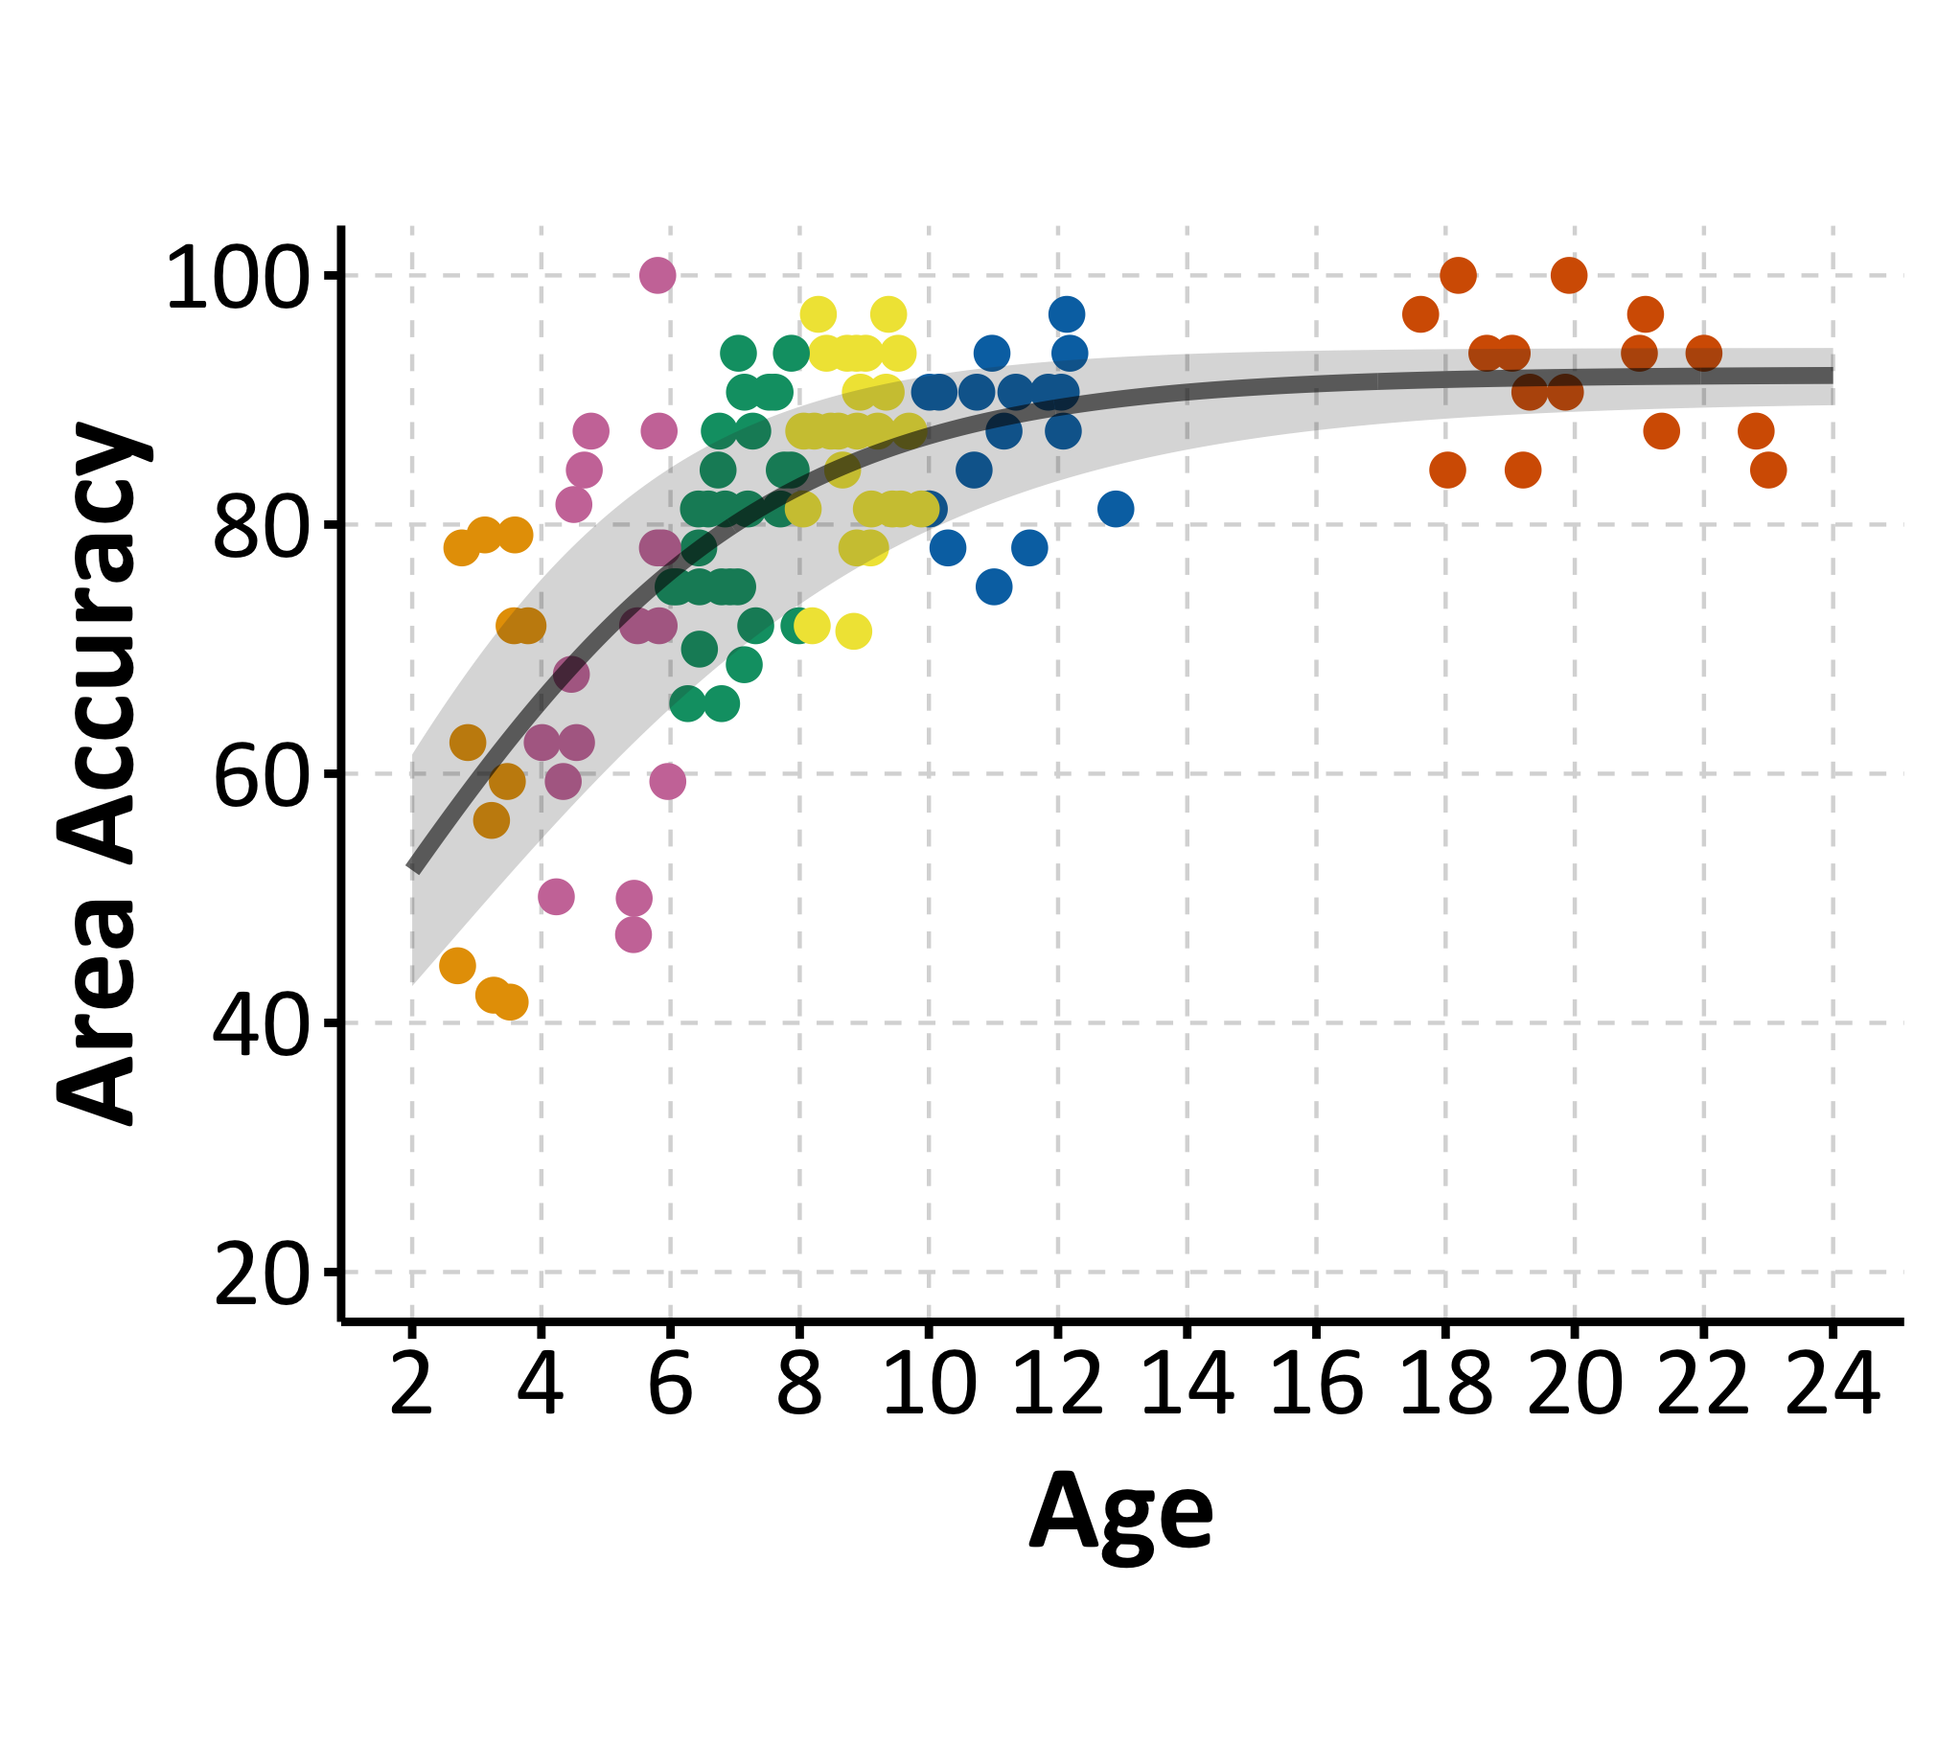
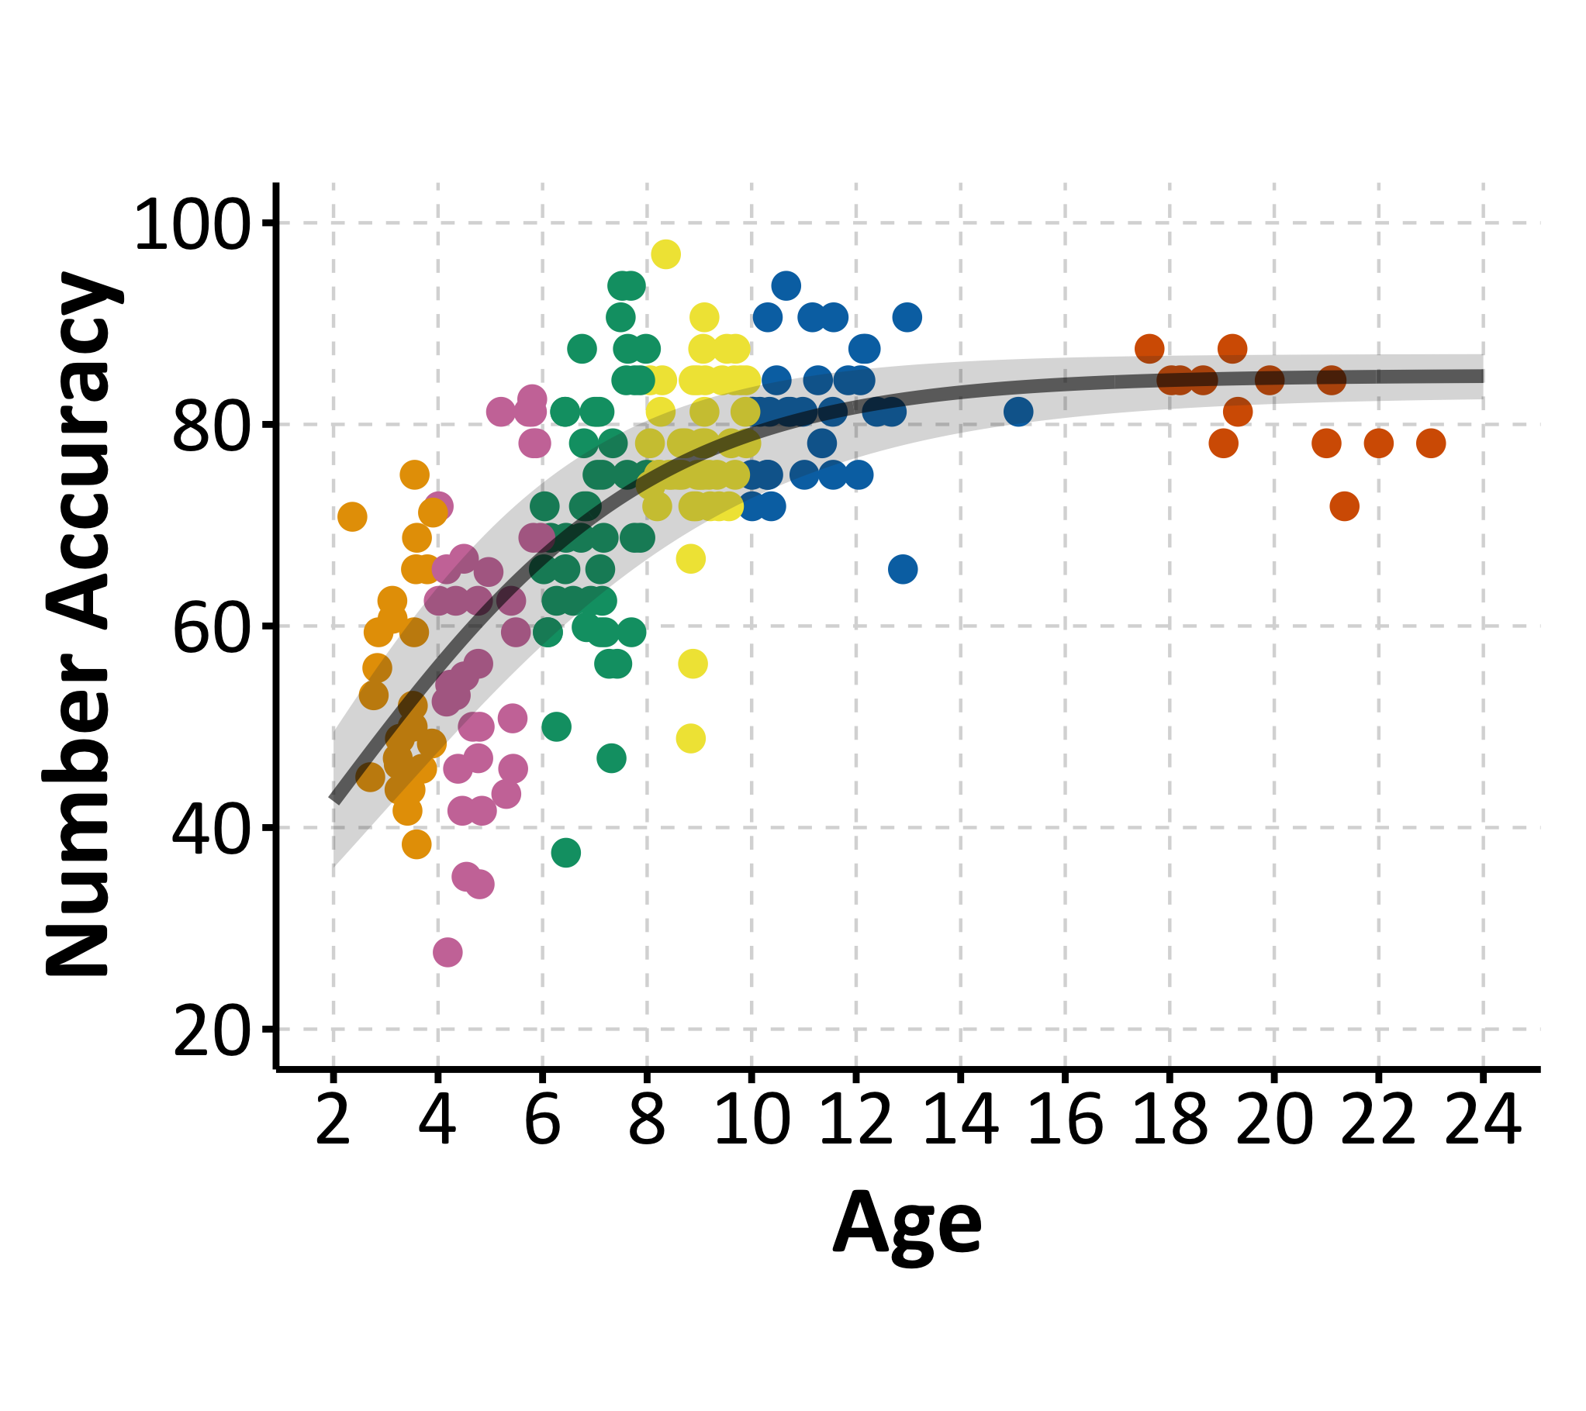
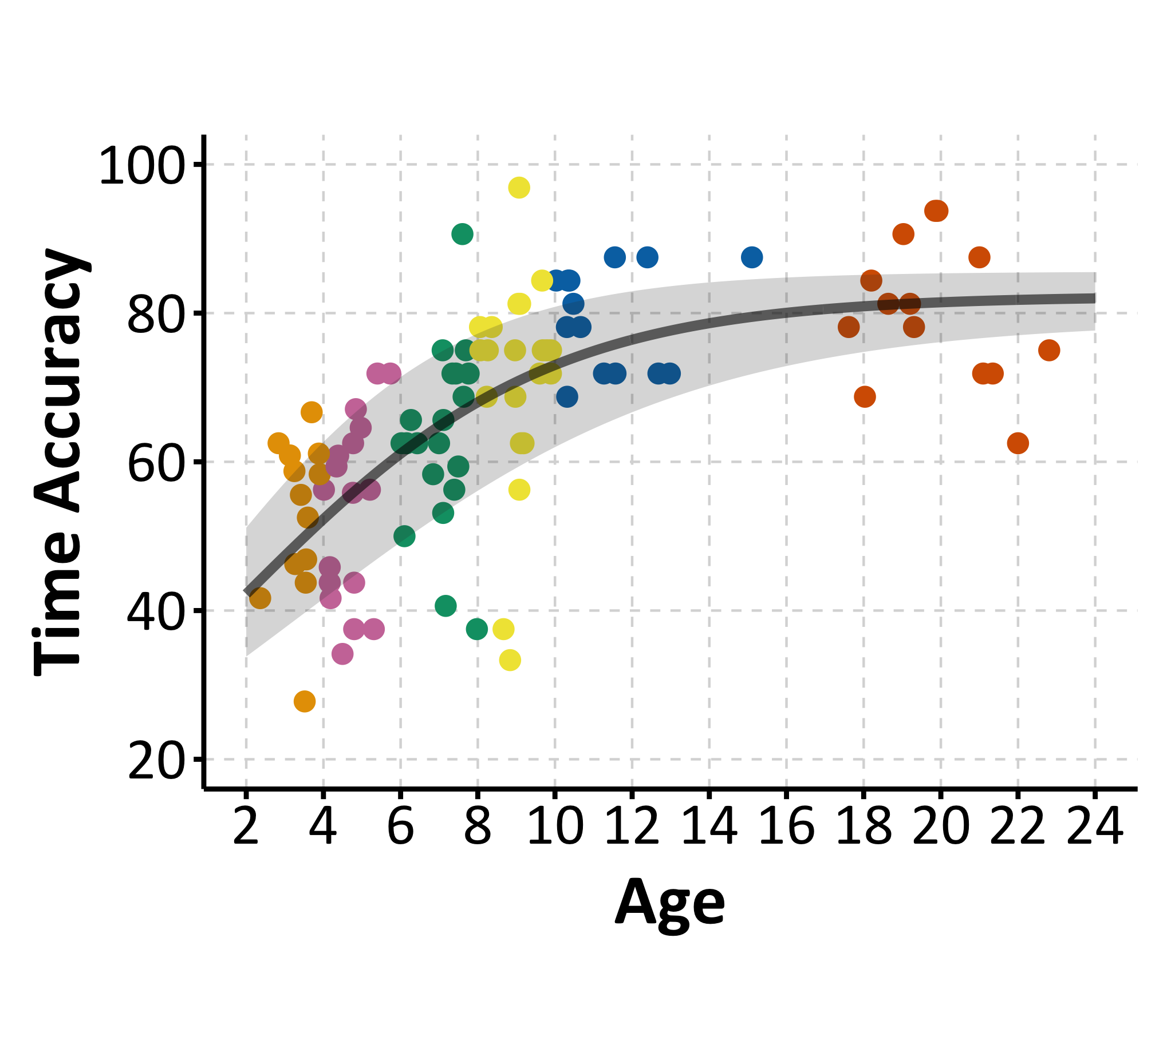
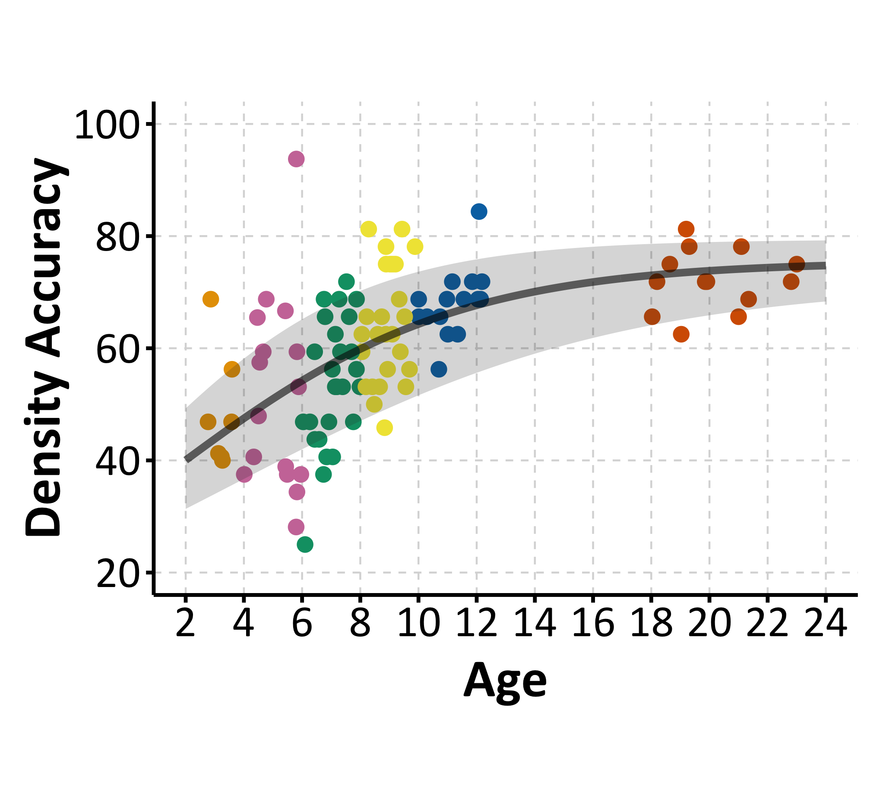
Experiment 1: Is number derived?
There are large differences in accuracy and development of the five dimensions: area and length are the most accurate and develop the fastest, and time and density the slowest.
Length: 13.0 (2.4)
Area: 14.8 (2.2)
Number: 15.6 (2.1)
Time: 19.4 (3.3)
Density: 22.9 (3.9)

Slide 8
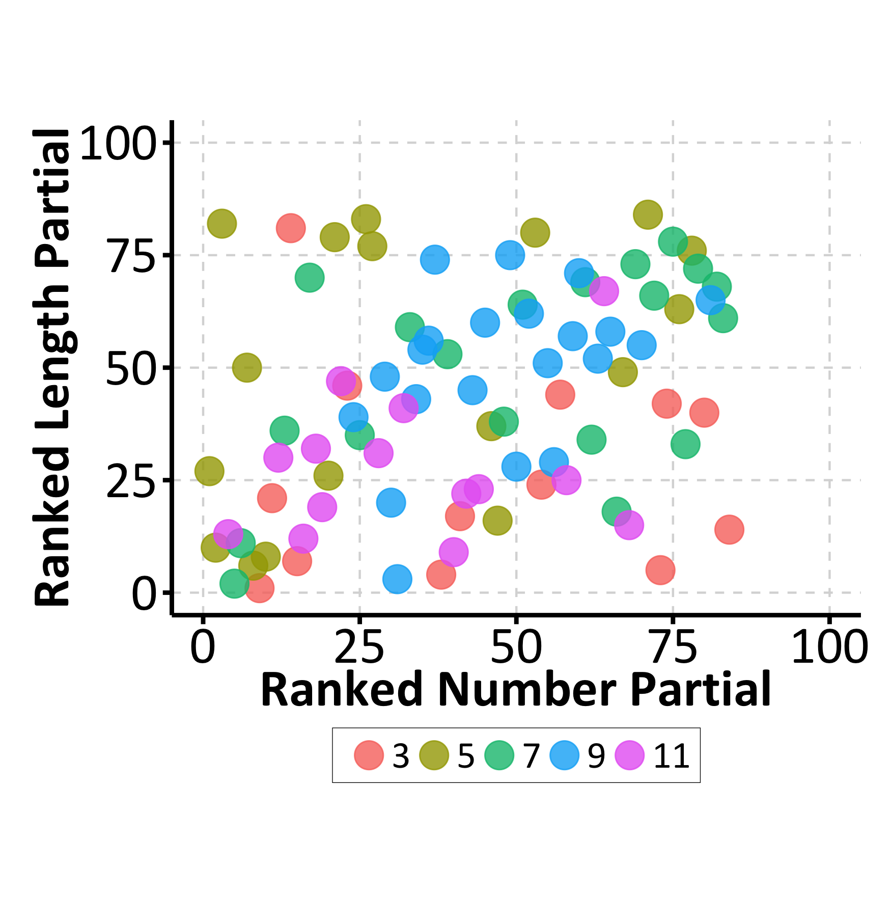
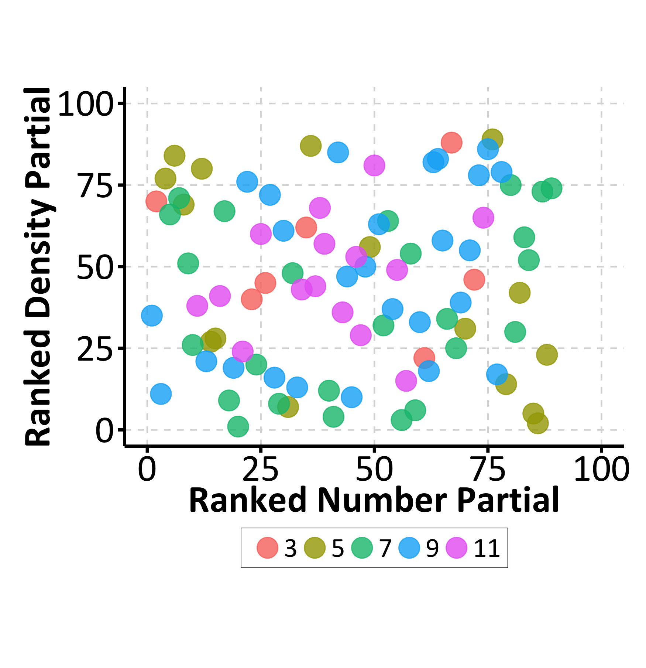
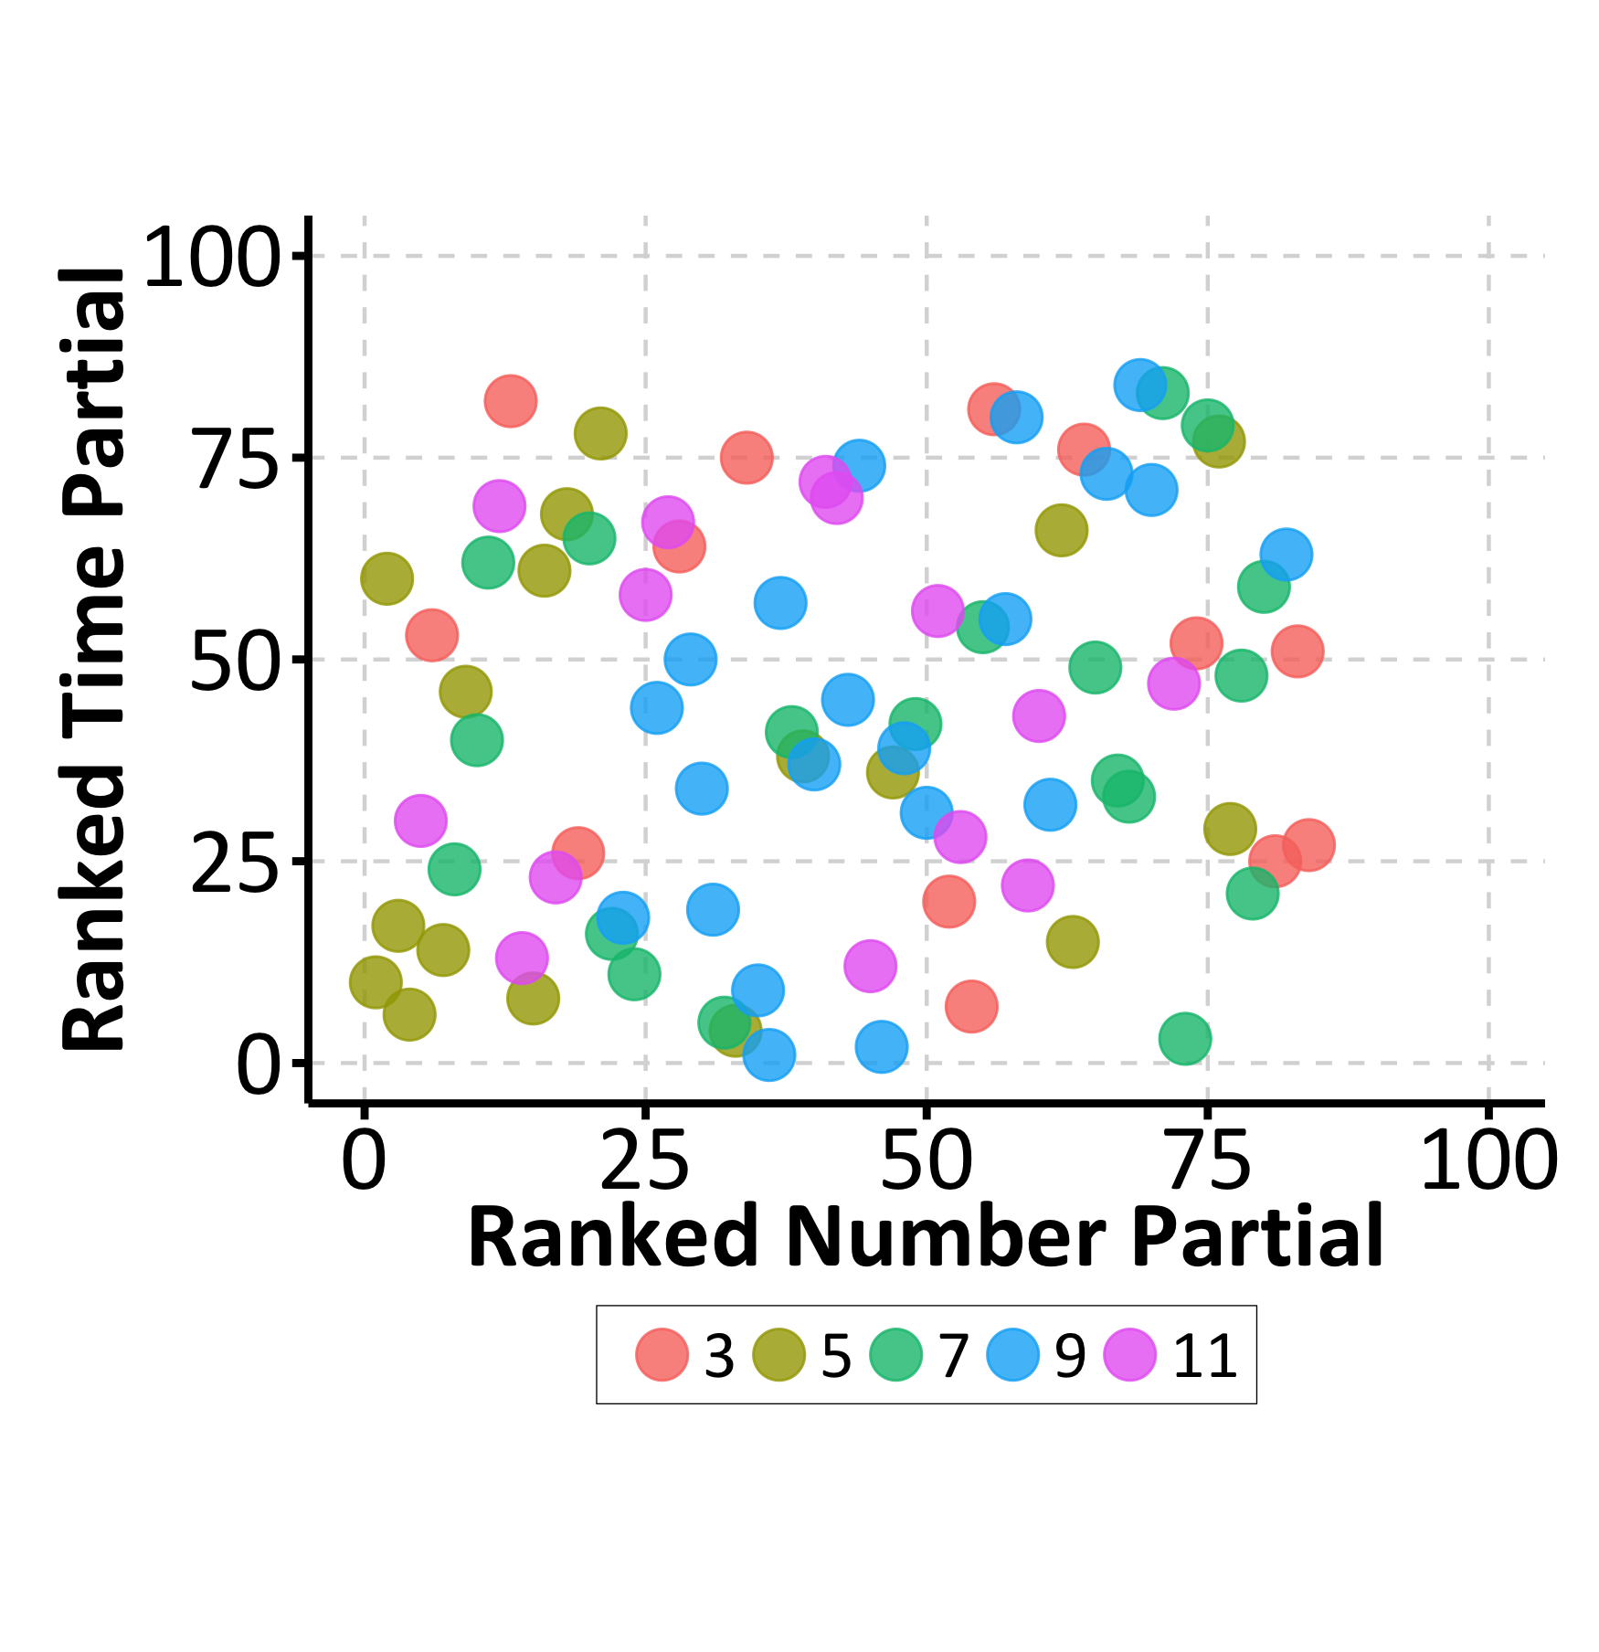
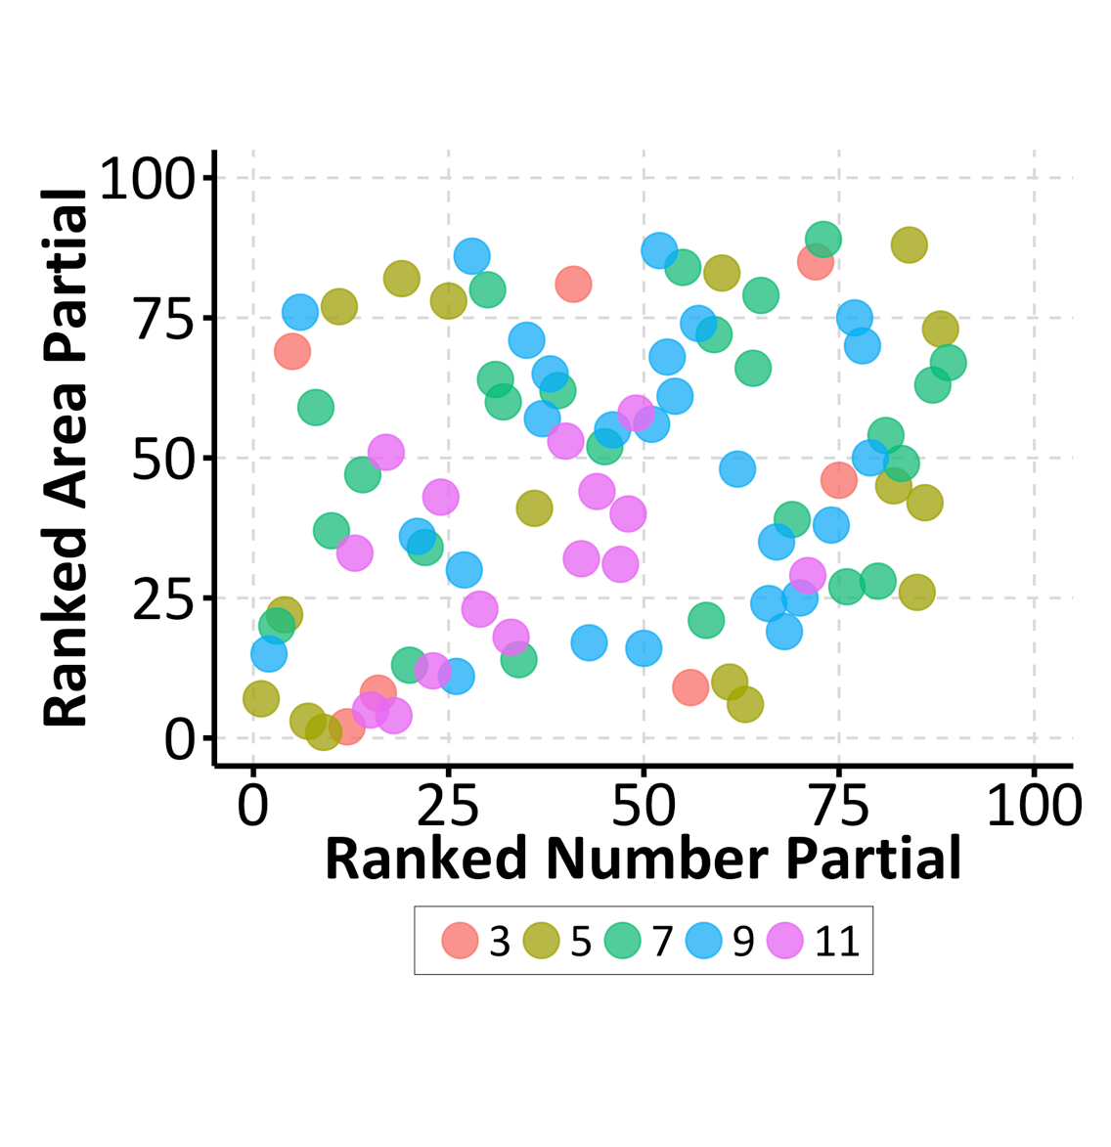
Experiment 1: Is number derived?
Do errors (i.e., accuracy) in number perception correlate with those in other dimensions?
Number & Area: No!
Number & Density: No!
Number & Length: No!
Number & Time: No!

Slide 9



Experiment 2: Naturalistic Images
But, perhaps the lack of correlations between number and other features is due to our stimuli artificially breaking the naturalistic correlations between number and other features.
Naturalistic images show good correlations between number and other features:
r(number, area) = .27
r(number, object size) = .40
r(number, convex hull) = -.40
r(number, density) = .44
r(number, occlusion) = .24

Slide 10
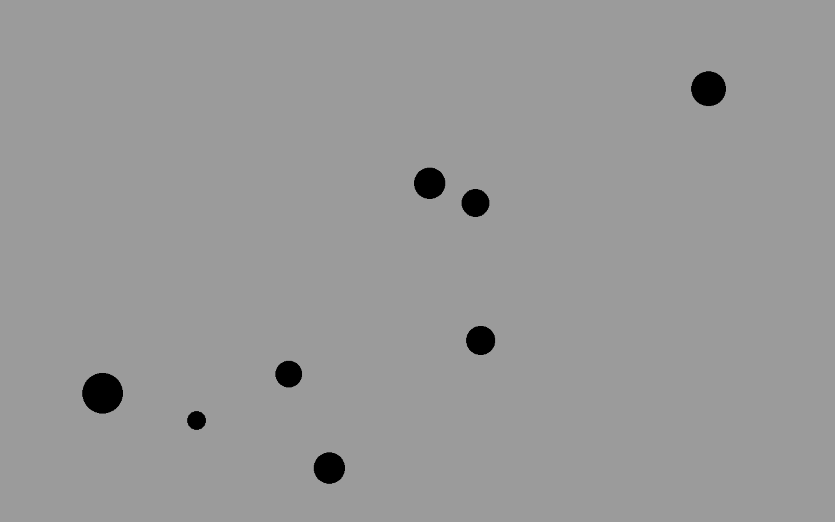
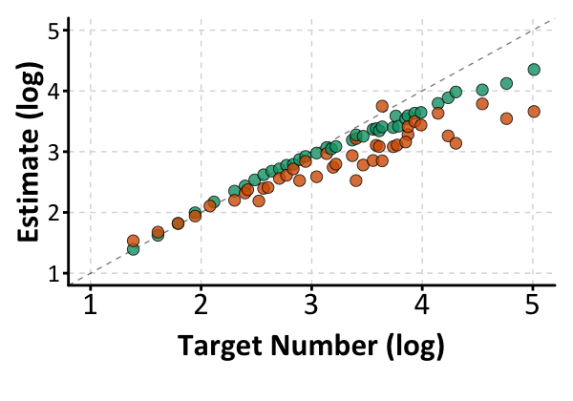
Experiment 2: Naturalistic Images
If participants are using non-numeric features, then we should expect naturalistic image estimation to be better than dot arrays.

Slide 11

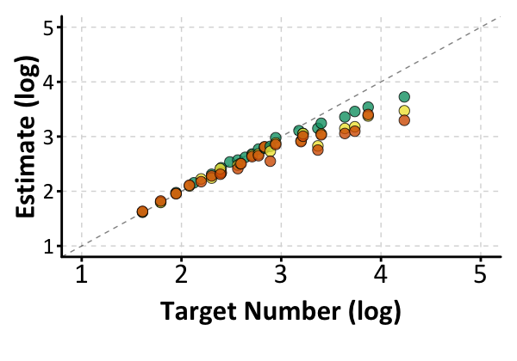
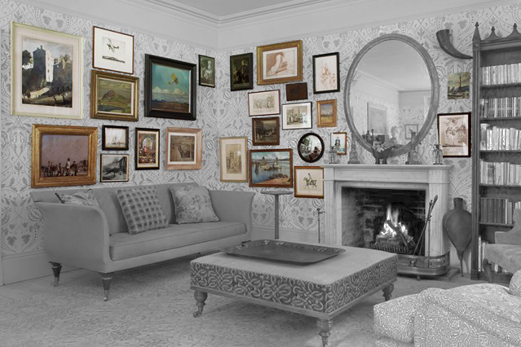
Experiment 2: Naturalistic Images
This finding held even when we helped segregate the target objects from the cluttered background context.

Slide 12
Part 1: Takeaways and Implications
Number, time, and space are represented independently of each other by our perceptual system, even in situations where naturalistic correlations could help improve accuracy.
Implications for visualization researchers:
Number is a readily and early developing perceptual feature that is automatically extracted by the visual system.
The precision of number representations is independent of the naturalistic correlations between number and other features.
Area and length are the most precise perceptual magnitudes, and density and time the least so. This has implications for other facets of perception (e.g., response competition).

Slide 13
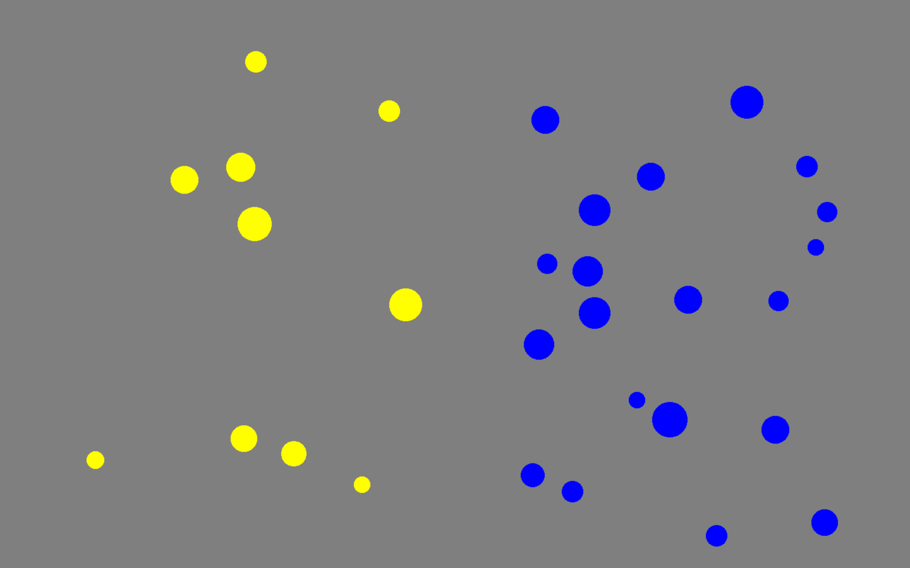
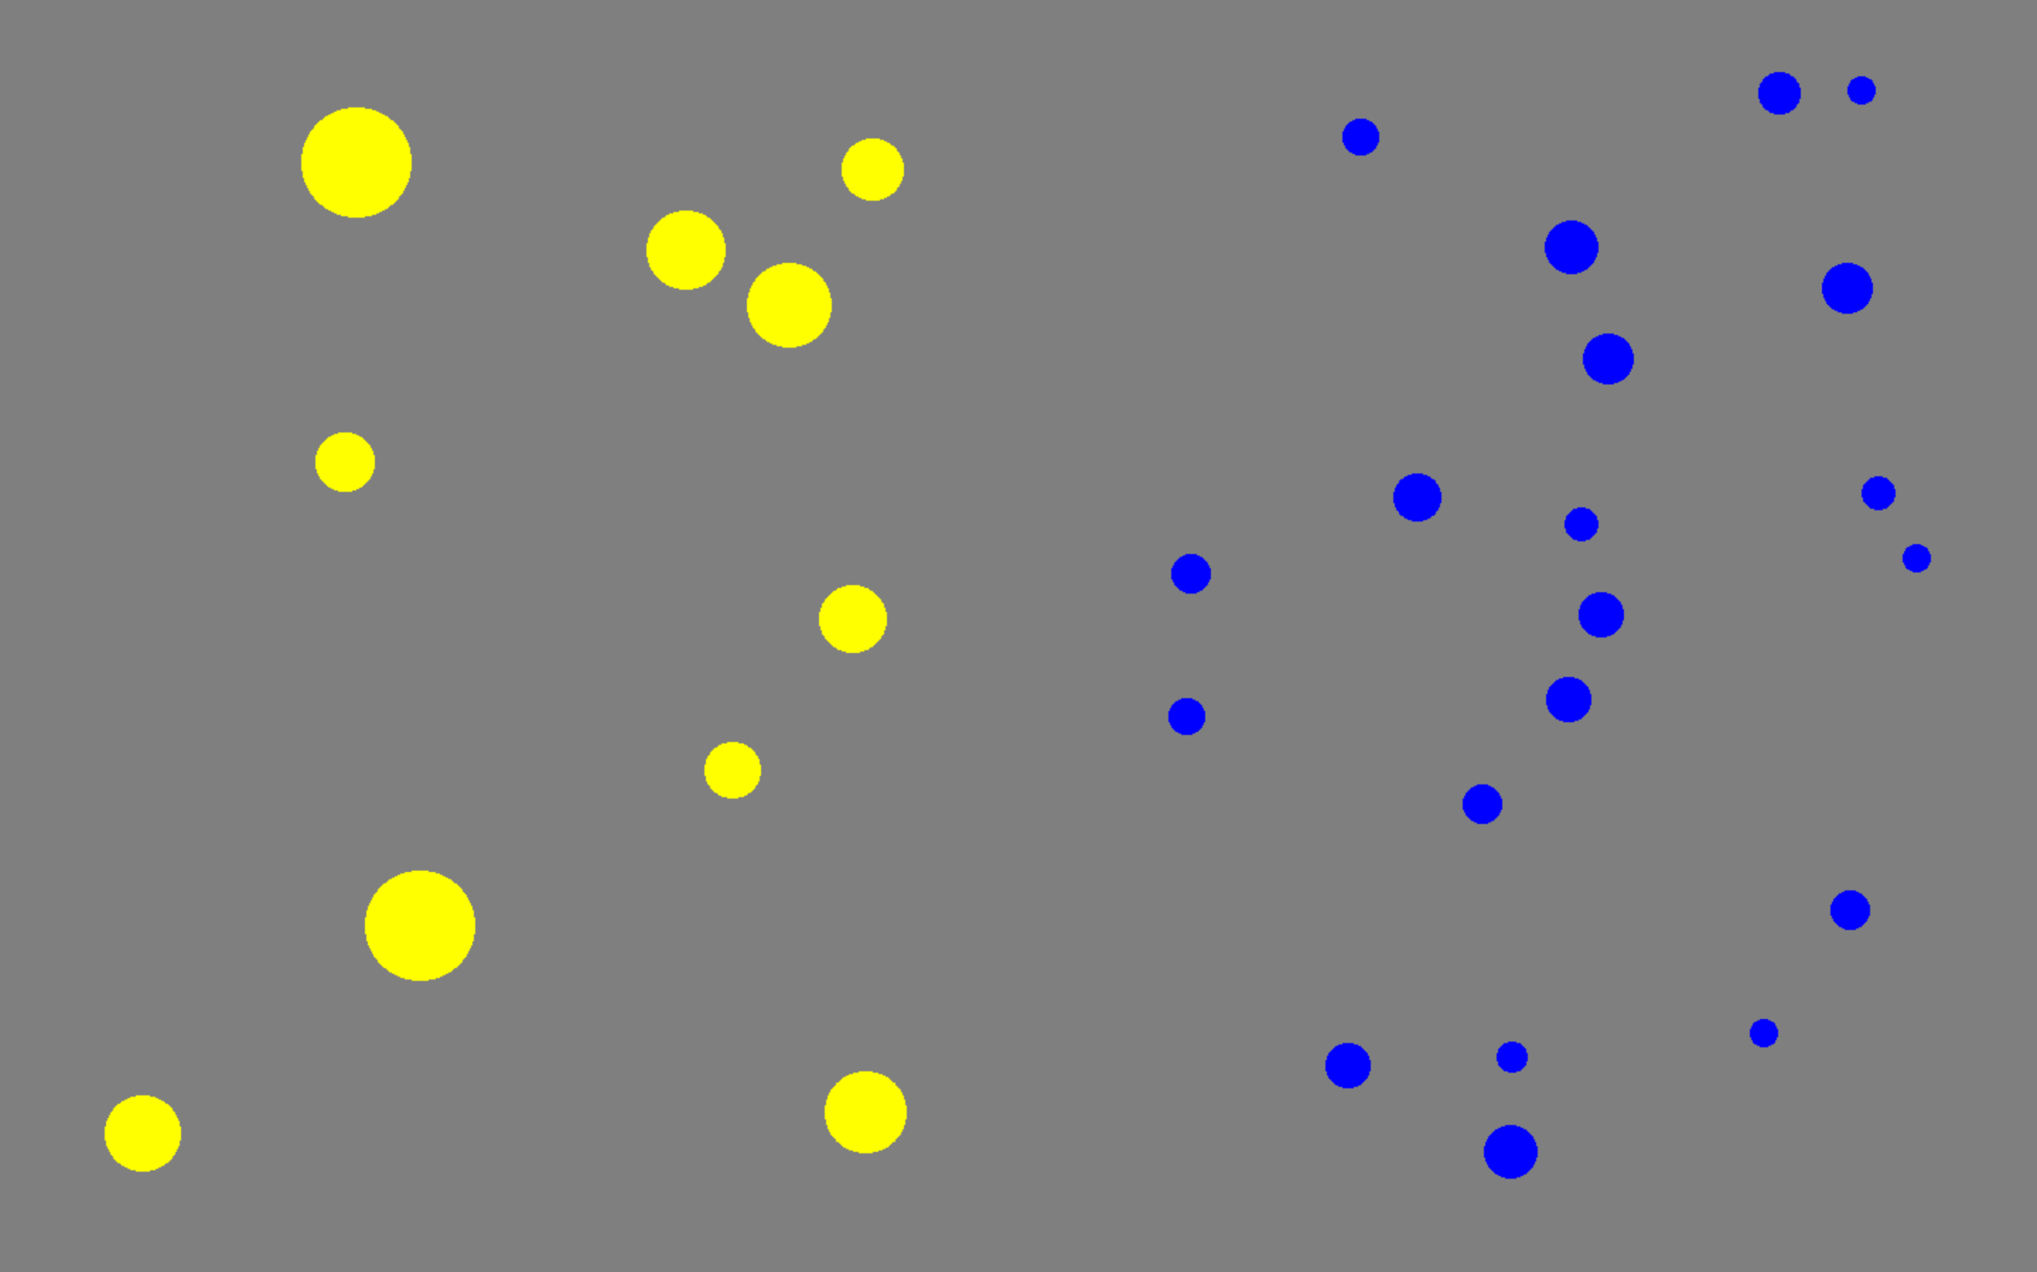
Part 2: Magnitude Interference
Despite their independence, number, time, and space actively compete for attention and response selection, resulting in interference/congruency effects.
Congruent
Incongruent

Slide 14
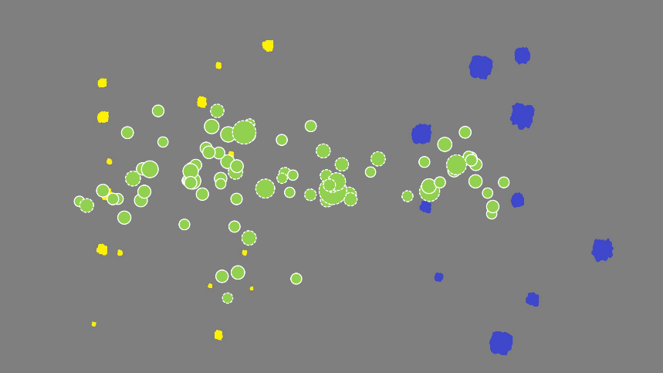
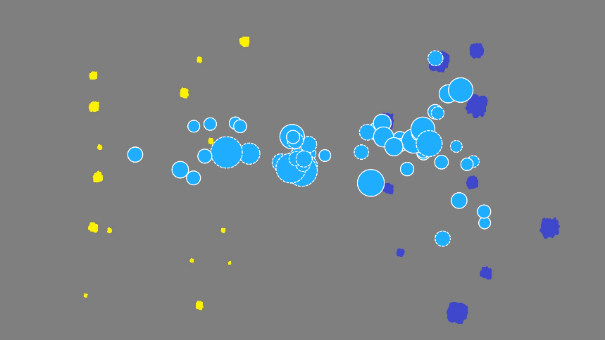
Experiment 3: Detecting Interference
There are large individuals differences in the magnitude of interference effects for observers.
One way they can be caught in real-time is with eye-tracking measures: participants who show larger congruency effects spend more time looking at the side with larger cumulative area.

Slide 15
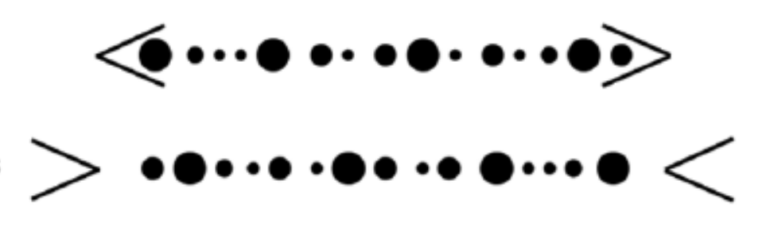
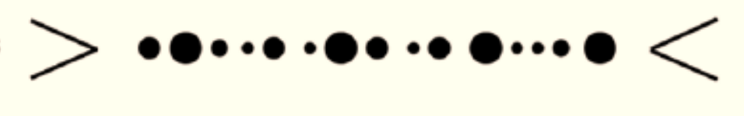
Experiment 4: Eliminating w/ Context
One way we’ve discovered interference can be eliminated is with task context: if the task allows for response competition (e.g., discrimination), interference will occur, but if it does not (e.g., estimation), it will be prevented.
Discrimination (“Which side has more?”)
Estimation (“How many on each side?”)

Slide 16
Experiment 5: Eliminating w/ Feedback
Another way of eliminating interference is with simple corrective feedback after each trial.
No Feedback
Feedback
Area Congruent
Area Incongruent
Area Congruent
Area Incongruent

Slide 17
Part 2: Takeaways and Implications
Number, time, and space compete for the same response and attentional resources. But, the interference is context sensitive.
Implications for visualization researchers:
If visualizations aim to draw attention to number, they need to strongly signal this, because participants are more drawn towards length, area, etc.
A person trained to look at number will see this information preferentially: experts should be mindful of how their visualization intention may differ from a naïve observer’s.
Visualizations with relative comparison are more prone to interference effects than those where absolute information needs to be pulled out.

Slide 18
Part 3: Absolute vs. Relative
Work across many labs has increasingly been showing that space and time representations are optimized for relative comparison.
Absolute representations (i.e., magnitude estimation) require a slow, serial, and error-prone process that is similar to counting.
As a result, while area and length representations are far more precise and less error prone when compared, they are much worse than number when estimated.

Slide 19
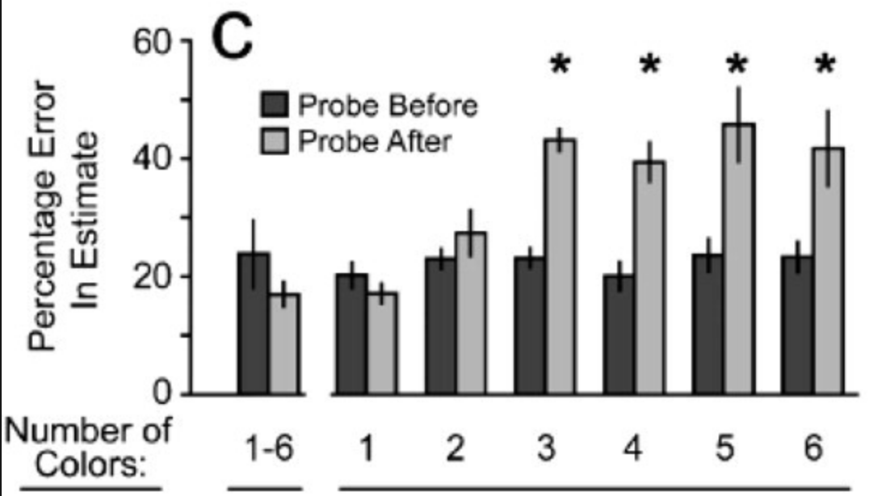
Experiment 6: Memory Limits
Previous work by Halberda, Sires & Feigenson (2008) has shown that – when estimating multiple ensembles – participants can only remember and recall the estimate of 2 – 3 sets.

Slide 20
Experiment 6: Memory Limits
But this same limit is eliminated in relative comparison (e.g., when asking participants to find the most numerous set, or the set with the largest cumulative area).

Slide 21
Experiment 7: Serial Estimation
Number estimation has famously been shown to be non-serial and precise: participants need as much time to estimate the number of 10 dots as they need to estimate 100. But this does not hold for length and area.
N = 100 adult observers.
All observers complete both discrimination and estimation.
“Estimate the ratio of the standard to the target value.”
Range of target values 8 – 22.
No feedback.

Slide 22
Experiment 7: Serial Estimation
While area and length discrimination performance is significantly better than number, area estimation accuracy is much worse and both are more variable than number.

Slide 23
Experiment 7: Serial Estimation
While number estimation is parallel (equal RT across target value), area and length are not (larger/longer target = longer RTs).

Slide 24
Part 3: Takeaways and Implications
While number perception is easy for both relative and absolute comparison, magnitude estimation for area and length shows surprising deficits: it is slow, serial, and imprecise, and does not match the ease with which relative comparison is done over these dimensions.
Implications for visualization researchers:
Length and area estimates are perpetually under-estimated, with 2D area being especially problematic.
While comparison can happen parallel – quickly and accurately extracting the minimal and maximal element – estimation requires search and hits memory limits, even when the set in question is the minimal/maximal one.

Slide 25

Thanks! Questions?
Collaborators:
Carolyn Baer (UBC)
Denitza Dramkin (UBC)
Danny Oppenheimer (CMU)
Justin Halberda (Johns Hopkins)
Lisa Feigenson (Johns Hopkins)
Jeff Lidz (UMD: College Park)
Paul Pietroski (Rutgers)
Tim Hunter (ULCA)
Grant Agencies:
NSERC Discovery Grant
SSHRC Insight Grant
Notes:
Let me summarize the results from this first experiment. Overall, we found evidence for similarity and for differences in number and area processing.
First, we found that both systems represent quantity as noisy approximations with overlapping activations. They also both share a comparison operation, that determines which quantity is greater based on the overlap between the representations. As a result, they both comply to this psychophysical model we’ve been talking about. Lastly, they share a developmental pattern, where they both increase in sensitivity with age.
At the same time, there are important differences. The most important of these is that the sensitivity between these two is different – area representations show higher sensitivity that number representations. As such, we can conclude that on the level of visual cognition there are likely to be two separate and independent systems: an approximate number system, and an approximate area system.

